Slide 1
Model Validation
Date

Slide 2
Using Validation Annotations
Required
StringLength
RegularExpression
Range
Validation and Model Binding
Validations run implicitly during model binding
Model Binder uses the model metadata to get all the validators
DataAnnotations ModelValidator can find all the validation attributes and execute the logic inside

Slide 3
Validation HTML Helpers
The Html.ValidationMessage() is an extension method, that is a loosely typed method. It displays a validation message if an error exists for the specified field in the ModelStateDictionary object
SYNTAX:
MvcHtmlString ValidateMessage(string modelName, string validationMessage, object htmlAttributes)

Slide 4
ModelState
ModelState contains the values and errors associated with each property
In case of errors the ModelState .is Valid returns a false
Controller Actions
Controller actions can decide when the model state is invalid and validation has failed.
When validation fails the action re-renders the same view that posted the values.

Slide 5
ASP.NET MVC client side validation is based on the jQuery validation plugin. It can be said that MVC’s client-side validation is an opinionated version of how jQuery validation should work in an ASP.NET MVC project
In Web.Config file
<configuration> <appSettings> <add key="ClientValidationEnabled" value="true" /> <add key="UnobtrusiveJavaScriptEnabled" value="true" /> </appSettings> </configuration

Slide 6
Custom Annotations
Derive from class ValidationAttribute
Override the is Valid method
ValidationContext will give you access to model type, model object instance and friendly display name

Slide 7
Security in MVC
Date

Slide 8
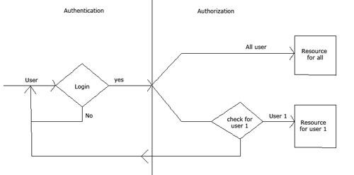
Authentication and Authorization

Slide 9
ASP.NET Identity
Asp.net Identity is the new way of authentication for Asp.net projects which is provided by Microsoft. It is a common authentication mechanism used by all the Microsoft framework such as Web forms, MVC, Web API etc. It also provide the functionality for user and role management in the system. It uses OWIN middleware for authentication cookie generation and social site's login credential capability. Asp.net Identity requires VS2015 and .Net 4.5 for functioning.
Enable role-based security
Role based accessibility is another integral part of web development because it provides encapsulation for designated information accessibility to designated credentials. Microsoft MVC paradigm provides a very simple and effective mechanism to achieve role based accessibility
Authorize attribute
Specifies that access to a controller or action method is restricted to users who meet the authorization requirement.

